Slide 1
The University of Queensland
School of Earth and Environmental Sciences
An Introduction to Finite Elements
With Application To Gravity Fields
Lutz Gross
E-mail : l.gross@uq.edu.au

Slide 2
Objective: Geophysical Imaging
constructing a 3D map of subsurface from from surface or near surface observation
  For instance: density ρ from vertical gravity g_{z}
This process is called inversion
  Key step: forward model
    calculate vertical gravity g_{z} at the surface from an estimated density distribution ρ

Slide 3
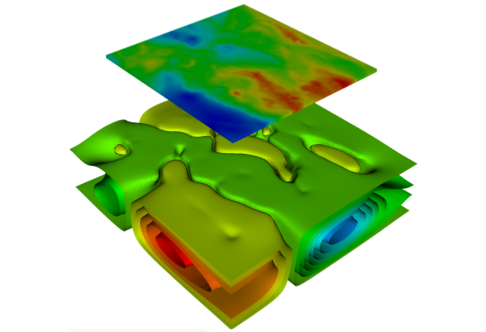
Geophyscial Imaging (cont.)
Example from Western Queensland
Given Data: vertical
gravity anomalies g_{z} at surface
Recovered 3D map:
surface density ρ

Slide 4


Gauss’s law for gravity
Gravity field g=(g₀,g₁,g₂) due to density ρ needs to fulfill:
Coordinate system x=(x₀,x₁,x₂):
  x₀,x₁ horizontal
  x₂=z vertical

Slide 5


Potential Field
gravity field is a conservative field:
Hence gravity field g the negative gradient of the so-called gravity potential u

Slide 6

PDE for the Potential
Partial Differential Equation (PDE) for the potential u
Spelled out in 2D: x₀ horizontal, x₁ vertical

Slide 7
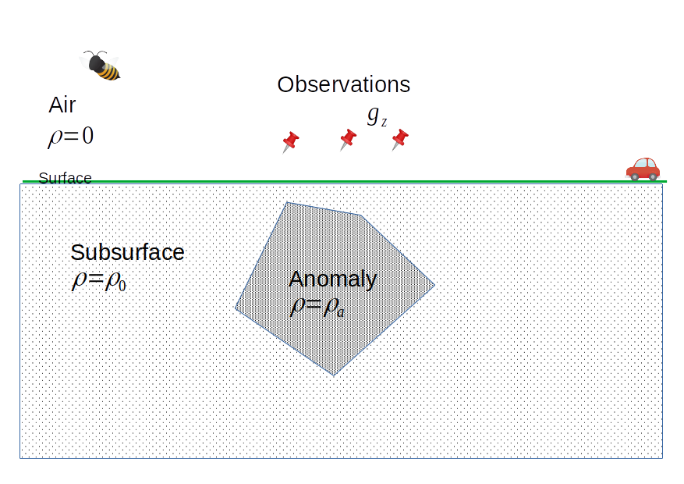
Anomalies

Slide 8



Background gravity
Common approach in geophysics:
  Eliminate the background field and properties from the problem → looking at anomalies
  Based on a ‘homogeneous half-space’ solution
Background model constant density + air layer
Residual model

Slide 9
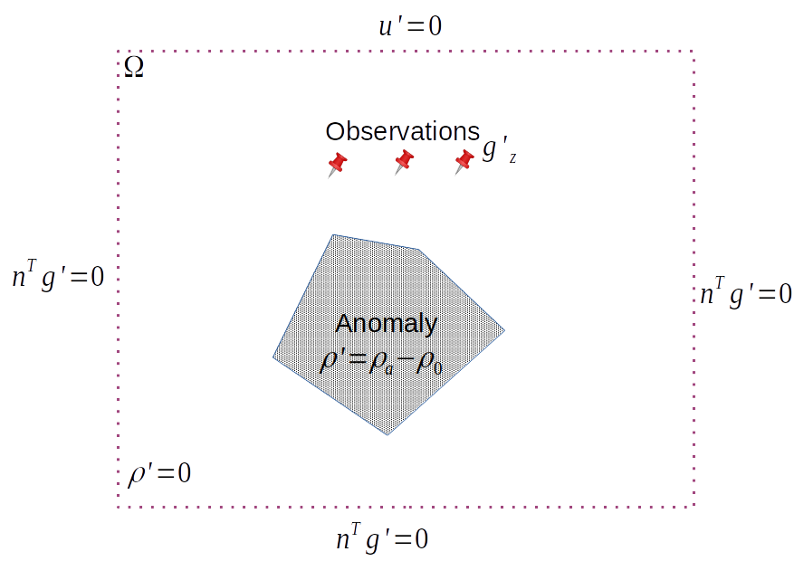
Residual Model
Assume bounded domain
Homogeneous boundary conditions

Slide 10


Boundary conditions
Dirichlet-type boundary conditions on Γ_{D}
  Γ_{D} = top of the domain Ω
Neumann-type boundary conditions on Γ_{N}
  Outer normal field n
    Set normal component of gravity field g to zero
  Γ_{N} = all other faces of the domain Ω

Slide 11

PDE we need to solve
Make life easy: drop the ‘
PDE for gravity potential u on domain Ω:
plus boundary conditions.

Slide 12
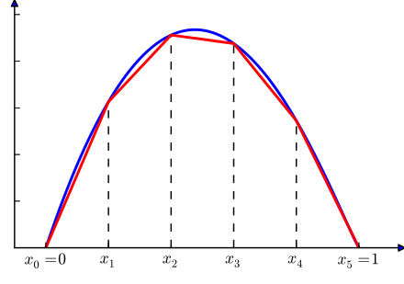
Finite Element Approximation
Idea: approximate the solution u by function u^{h} that is
  continuous
  piecewise linear
  solves the PDE (somehow)
solution u
approximation u^{h}

Slide 13
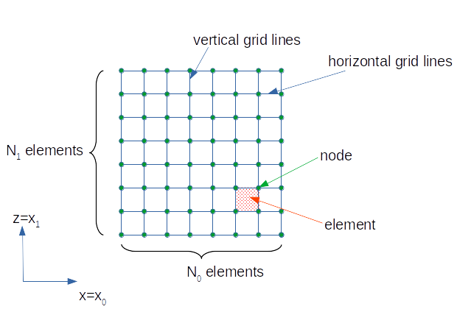
It all starts with a Grid
row i₁
E=(i₀,i₁)
column i₀

Slide 14

Grids
Subdivide the domain into an array of elements arranged in N₁ rows and N₀ columns
  A total of N₁ N₀ elements, and
  A total N=(N₁+1)(N₀+1) nodes
The set of all these nodes:

Slide 15
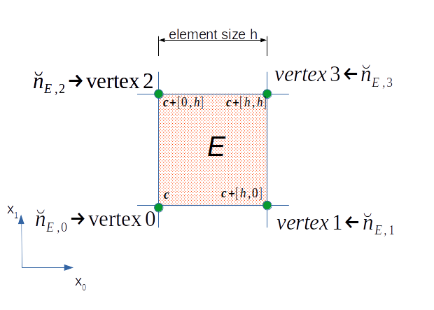

Elements
The set of elements is an unordered list
An element is described by the node ids of its vertices:

Slide 16
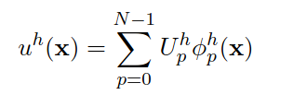
FEM Approximation
FEM approximation is a linear combination of the FEM basis functions ϕ_{p}^{h} with p=0,…, N-1
Unknown coefficients U_{p}^{h}
basis function ϕ_{p}^{h} is associated with node p

Slide 17
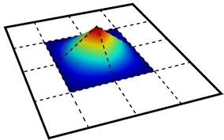
FEM Basis Function
Properties of basis function ϕ_{p}^{h}
Continuous function
Value one at node p
Value zero at all other nodes q≠p
Linear function on each element
Hence: it is identical zero on all elements that do not contain node p as vertex
ϕ_{p}^{h}
At Node p
x₁
x₀

Slide 18
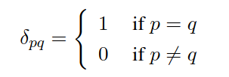

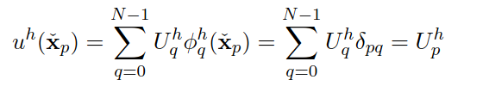
Duality
There is a duality of basis functions and nodes
Hence: coefficient U_{p}^{h} is the value of the FEM approximation at node p:

Slide 19


Some Notations
Vector of node values U^{h}:
  Component of U^{h} called degrees of freedom (DOFs)
arrange the basis function as a vector:
FEM approximation in a convenient way

Slide 20

Basis Function on an Element
On element E basis functions are bi-linear polynomial
    x₀,x₁ in element E,
a,b,c and d are suitable factors depending on node p and element E
  Determined by the duality condition!
Note: a=b=c=d=0 if node p is not in element E

Slide 21

Local Basis Functions
Local basis function = part of the global basis function on an element
  Obviously: we are looking at non-zero part only
  Here: four local basis functions N₀, N₁, N₂, N₃:
N₀ @E=(1,2)
N₀ @E=(2,2)
N₂ @E=(1,1)
N₄ @E=(2,1)

Slide 22
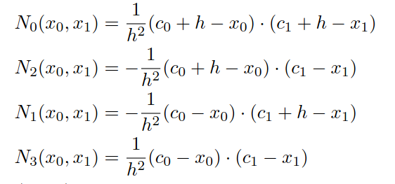
Local Basis Functions
For square element with edge length h and left-lower corner c=(c₀,c₁)
Task: Check duality with the four vertices (c₀,c₁), (c₀+h,c₁), (c₀,c₁+h), (c₀+h,c₁+h)

Slide 23


The FEM Solution
Motivation: get the FEM approximation u_{h} with the best gravity approximation:
in the root means square (RMS) sense:

Slide 24

Condition for FEM solution
Apply ` virtual displacement`:
Perturb solution u^{h} by small increment v_{h}=ϕ_{p}^{h} for any node p:
Then we have for any α :

Slide 25
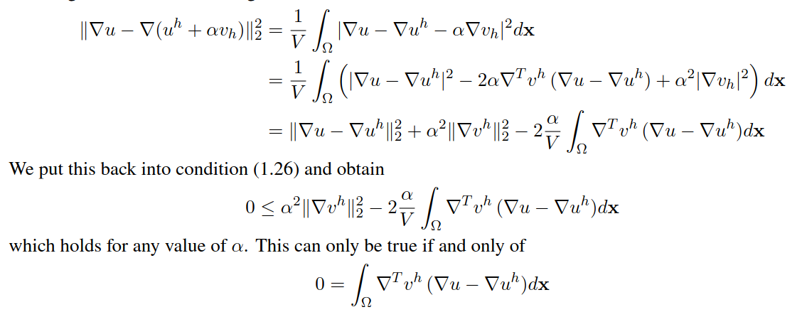
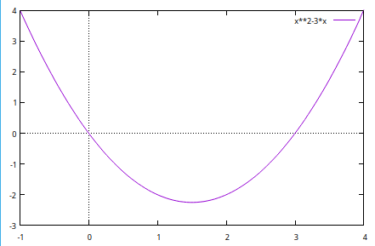
A bit of calculus:
α

Slide 26

FEM Solution
So FEM uh needs to fullfil this condition for all basis functions v^{h}=ϕ_{p}^{h}
But we don’t know the solution u ?
  Somehow we need to use:

Slide 27


FEM Solution (cont.)
Split integration over domain into integration over elements individual E:
apply Green’s first identity on each element

Slide 28



FEM Solution (cont.)
Insert PDE:
Two elements E₁ and E₂ with touching faces have normal n₁ and n₂ with opposite signs:
Hence: as v^{h} is continuous across element edges:

Slide 29

Boundary conditions:
Neumann-type boundary conditions on Γ_{N}
Dirichlet-type boundary condition on Γ_{D}
  Only use v^{h}=ϕ_{p}^{h} with node p not in Γ_{D}

Slide 30

Condition for FEM Solution
Putting it all together:
  Find uh that fulfills the following conditions
    Meets the Dirichlet boundary condition: u^{h}=0 on Γ_{D}
    For all v^{h} with v^{h}=0 on Γ_{D} :

Slide 31

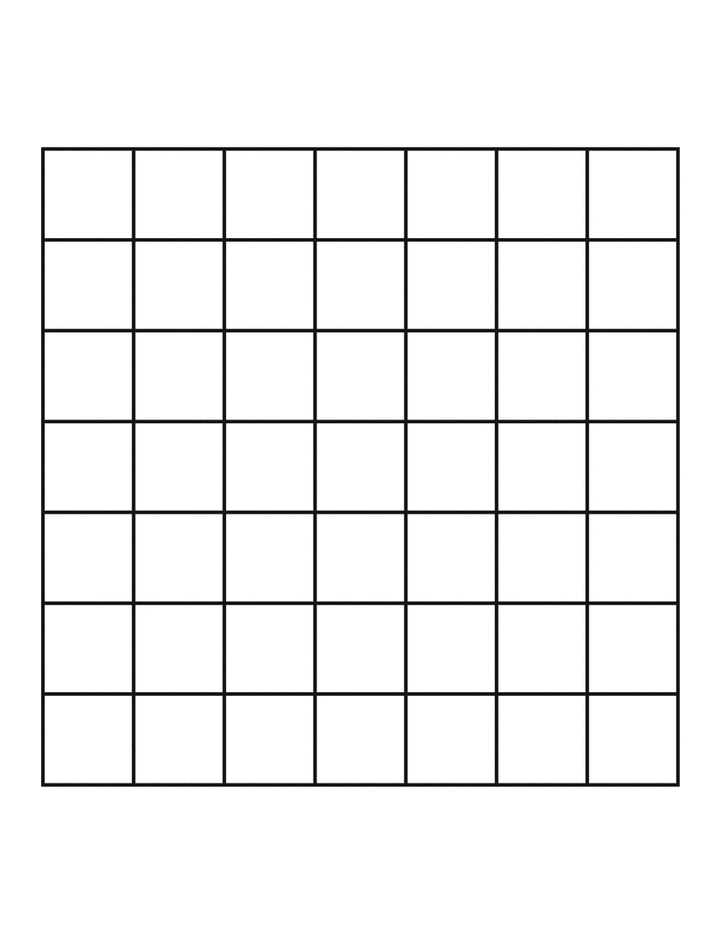
System of Linear Equations
Recall:
Dirichlet condition ‘u^{h}=0 on Γ_{D} ‘ translates:
  If node p in Γ_{D} then
eg. all nodes localeted at the top face of the domain

Slide 32
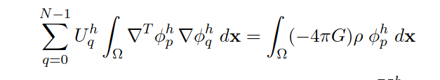
System of Linear Equations (cont.)
With v^{h}=ϕ_{p}^{h} for node p not in Γ_{D}
This is a system of
  N equations: one at each node
  N unknowns = values of u^{h} at the nodes

Slide 33





Compact form
In compact form this is
With (ignoring Dirichlet Boundary conditions):

Slide 34

Matrix Structure
S^{h} is called stiffness matrix
Entries can be obtained element-by-element
  Hence: S^{h}_{pq} is zero if there is no element E that has node p and q as a vertex.

Slide 35
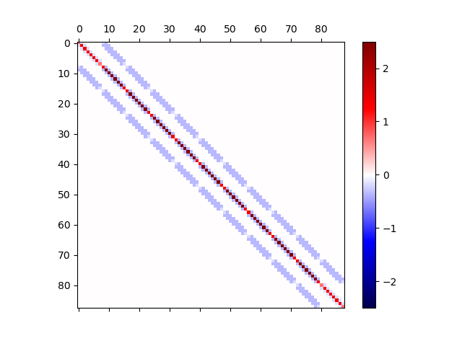
Matrix Structure (cont.)
The stiffness matrix is sparse
  The number of non-zero entries is small compared to the size of the matrix

Slide 36
Sparsity
Use special compressed formats such as
  compressed sparse row (CSR): stores value + column index
  dictionary of keys (DOK): stores value + (column, row) index
For our case:
  Size of full matrix N²
  Number of non-zeros: about 8 N
    As each node has maximum of 8 neighboring nodes connected via an element.
  For a 100x100 grid:
    Sparsity < 0.08%
    Savings of memory for CSR format: around a factor 600

Slide 37


Numerical Properties
The stiffness matrix is
    Symetric:
    Positive definite:
  See lecture nodes for details
Solution methods for the linear system:
  Direct method: Sparse LU factorization
  Iterative method: Conjugate Gradient method

Slide 38
Matrix Assemblage
The matrix and right-hand-side is build up on an element-by-element base.
  This can be done in any order!
We need an enumeration of the global nodes
  Determines the sparsity pattern of non-zero entries in the stiffness matrix
    Is impacting on computational performance and memory requirements

Slide 39
Node Enumeration
Here we use a grid row-by-row scheme:
  First count along the x_0 axis and secondly along the x1-axis:
  Lower, left corner:
    (i₀,i₁)=(0,0): n=0
  Upper right corner:
    (i₀,i₁)=(N₀,N₁): n=N₀ N₁-1
i₁
i₀

Slide 40
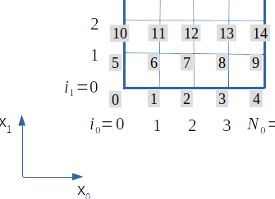
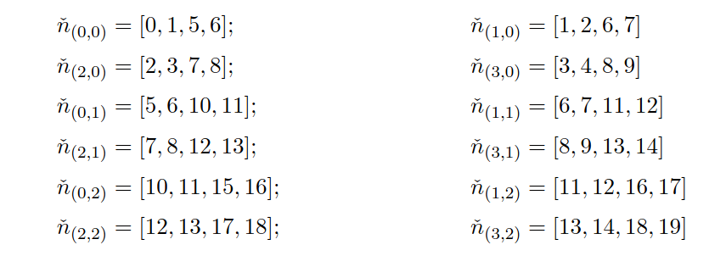
Example
Element E=(i₀,i₁)

Slide 41


Local Element matrices
Evaluate the local version of the PDE using the four local basis functions N₀, N₁, N₂, N₃:

Slide 42

Add to Global Stiffness matrix
Recall the connection between local and global basis functions:
This tells us where to add the local element matrices:

Slide 43

Get the local element matrices ..
Assume: density ρ is constant in each element
  Density is given as an array:
We know the local basis functions so the integrals can be calculated analytically
  They are scaled version of element matrix for edge length h=1.

Slide 44

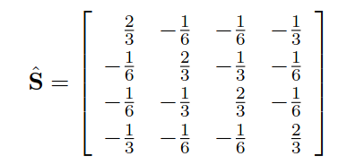


Element Matrices for Gravity
For element E with
edge length h
edge length h=1

Slide 45


Dirichlet-Type Boundary condition
Once the the stiffness matrix is assembled eliminate rows corresponding to nodes p with Dirichlet-Type boundary condition.
Simplest way: overwrite row p with equation:
That is:

Slide 46

Gradient Calculation
Gradient of FEM solution is not continuous.
calculated at element centers m^{E}:
Collects values given at FEM nodes
at the element vertices

Slide 47


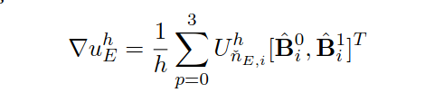
Gradient Calculation (cont.)
Again this can be relayed back to local basis function on an element with edge length h=1:
And then:

Slide 48
Pseudo program
Initial stiffness matrix S and right hand side b
for all element E
  Calculate local element matrices S_{E}, b_{E}
  Add S_{E}, b_{E} onto S and b
Overwrite equations for Dirichlet conditions in S and b
Solve AU=b
Return FEM solution U at FEM nodes.

